Slide 1

Scrum Methodology
Scrum is a popular Agile framework. It helps teams work efficiently. Scrum breaks down complex tasks. Teams deliver high-value products.
by
KISHORE.K

Slide 2

What is Scrum?
1
Agile Framework
2
Self-Organizing Teams
Scrum is a lightweight Agile framework. It manages complex software development.
Teams self-organize and work collaboratively. They work toward a common goal.
3
Iterative Development
Delivers high-value products efficiently. It uses incremental and iterative development.

Slide 3




Key Advantages of Scrum
Lightweight
Self-Organization
Team Collaboration
Offers a minimalistic structure. It doesn't overburden teams.
Empowers team members to take ownership. They manage their own tasks.
Encourages regular communication. It solves problems faster.

Slide 4

Scrum Lifecycle
1
Sprint
Time-boxed development cycle. It lasts less than one month.
2
Release
Completed product is delivered to the customer.
3
Sprint Review
Evaluate remaining features and product backlog.
4
Sprint Retrospective
Assess quality and project status after sprint.

Slide 5
Scrum Advantages
Faster Delivery
Customer Satisfaction
Improved Quality
Scrum focuses on short cycles. Output is faster and costs are lower.
Regular customer feedback ensures alignment. The product meets customer needs.
Ongoing testing enhances product quality. Feedback is gathered each sprint.

Slide 6

Scrum Disadvantages
Limited Change
Incomplete Framework
Discourages changes during a sprint. This can be restrictive.
Provides limited technical guidance. Integration with other frameworks is needed.
Undefined Projects
May not suit projects with unclear objectives. Requirements change frequently.

Slide 7
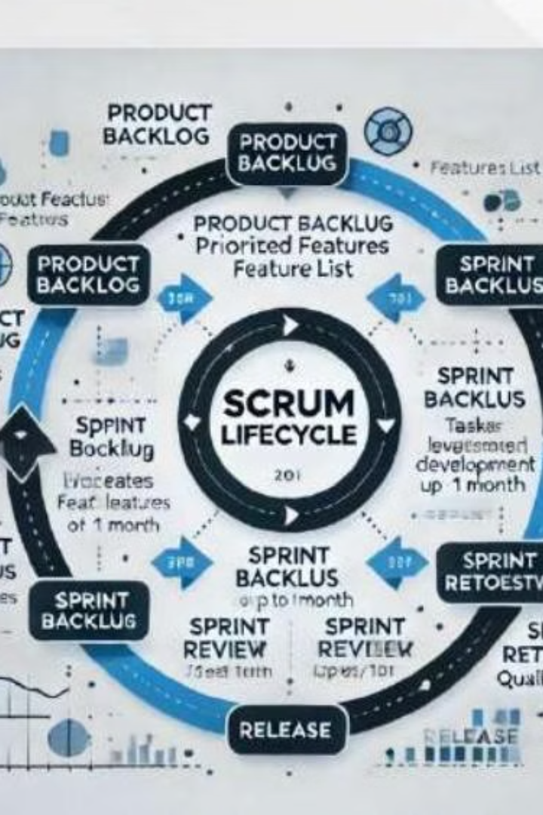



Scrum: Key Takeaways
Collaboration
Encourages team collaboration and adaptability.
Delivery Speed
Improves delivery speed and product quality.
Customer-Driven
Beneficial for customer-driven environments.

Slide 8

Conclusion
Scrum is a powerful Agile framework. It encourages collaboration. It improves delivery speed and quality.
Effective implementation requires discipline. It needs commitment and skilled personnel.

